Slide 1

Vinay Kumar Pallerla

Slide 2
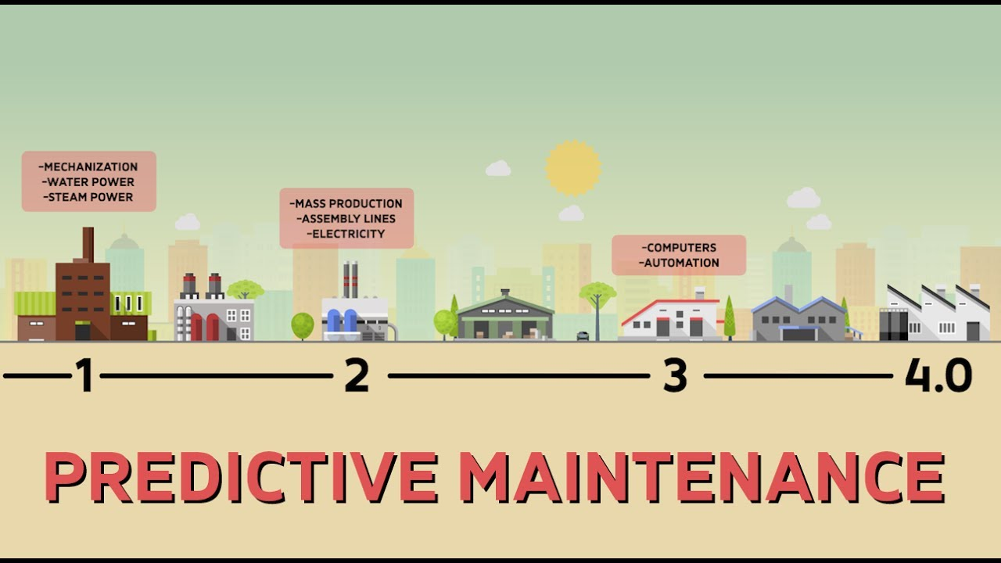

Slide 3
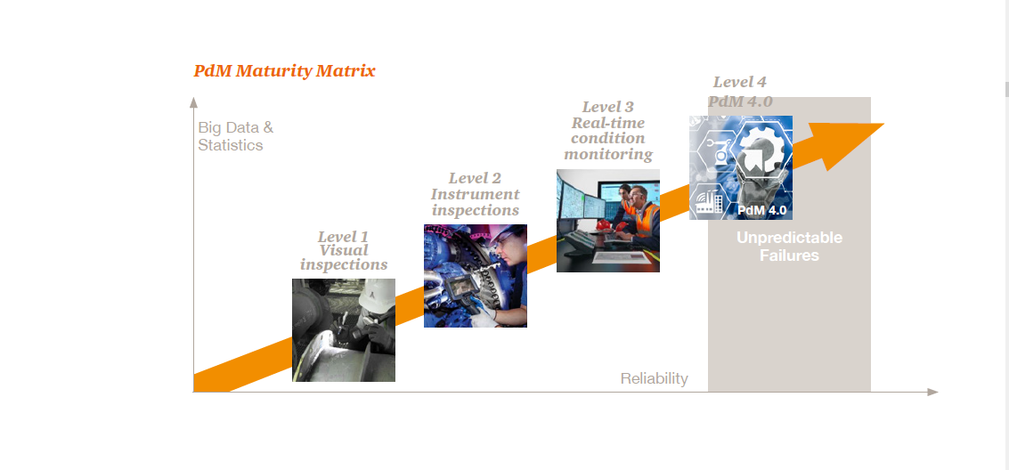

Slide 4
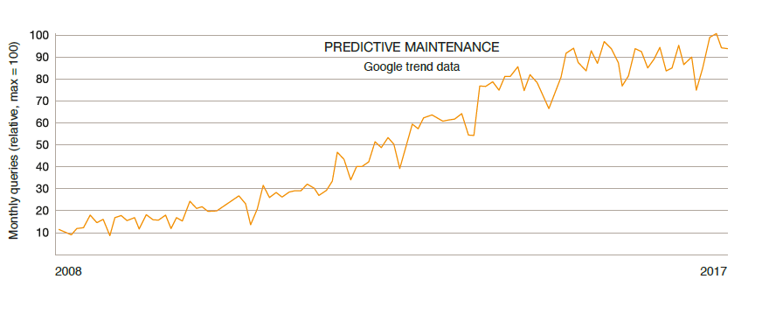
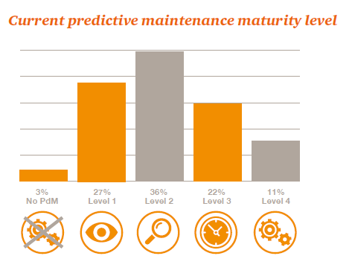
Growing Buzz & Current Maturity State

Slide 5
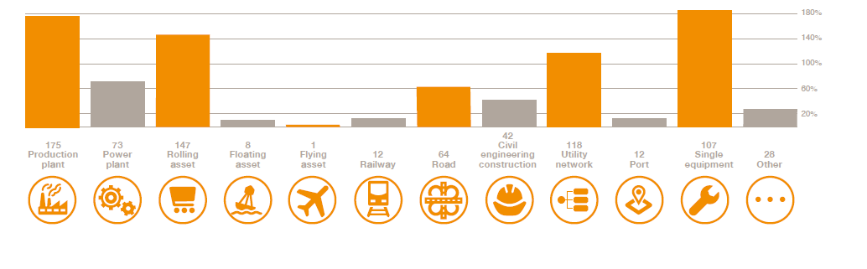
Types of Assets for maintenance
Note: Survey performed by PWC & Mainnovation in 280 companies across Belgium, Netherlands and Germany

Slide 6
Problem Statement
Build analytical model to predict future action point for all the machines of a locomotive automobile manufacturing unit.
Target classes – Component Repair, Component Replacement and No issue
Type of problem: Multi-class classification.
Train data has 674 machines ID’s and Test data has 324 machine ID’s.
Evaluation Metric- F1 score of Component replacement class.
Data Sources :
Complaints log which has errors data with time stamp.
Machine Details with Machine ID model and service period
Components service log- both scheduled and unscheduled services
Hour wise sensors data for the machine ID’s
Component replacement data with time stamp.

Slide 7
Approach
Understand the problem
Data pre-processing
Explore the models available to solve the problem
Implement all the possible models
Evaluate the performance of models and pick the best
Model Building Steps
Read in the data
Understand the data and the fields.
Do pre-processing
Build the model
Test the accuracy in local test.
Predict for the given test data
Upload the predicted output into grader

Slide 8
Field Layout of Data Sources
Component ServiceLog
Year
Month
Day
Time
MachineID
ComponentAttended
ServiceType
ComplaintsLog
Year
Month
Day
Time
MachineID
ErrorID
Component ReplacementLog
Year
Month
Day
Time
MachineID
ErrorID
Operating conditions
Year
Month
Day
Time
MachineID
Sensor1
Sensor2
Sensor3
Sensor4
Train Data
MachineID
ActionPoint
Test Data
MachineID
ActionPoint *
Machine Details
MachineID
MachineModel
ServicePeriod
* Target class to be predicted in test data

Slide 9
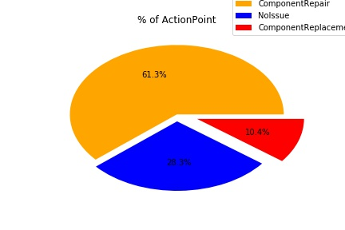
Exploratory Data Analytics
Observations:
Class Imbalance Problem.
Data Sources needs to be aggregated at a Machine ID level.
Data Source: Train Data

Slide 10
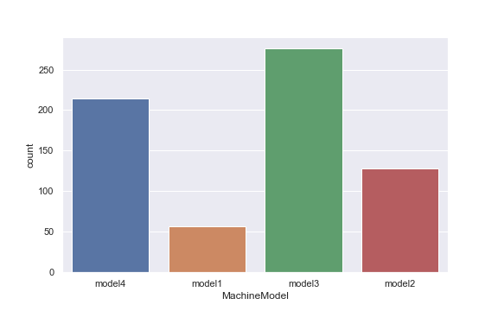
Machine Details

Slide 11
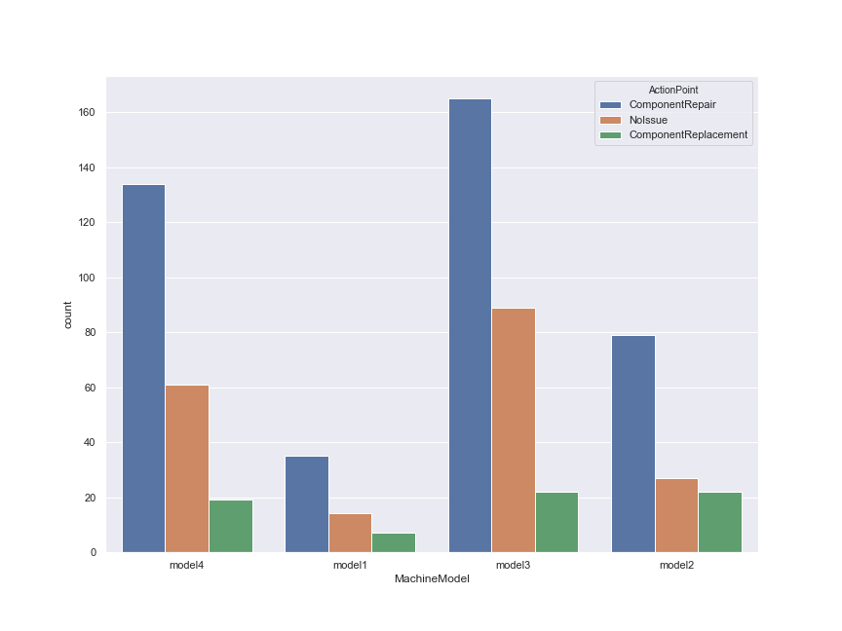
Model | % of Component Replace
model4 | 9%
model1 | 13%
model3 | 8%
model2 | 17%

Slide 12
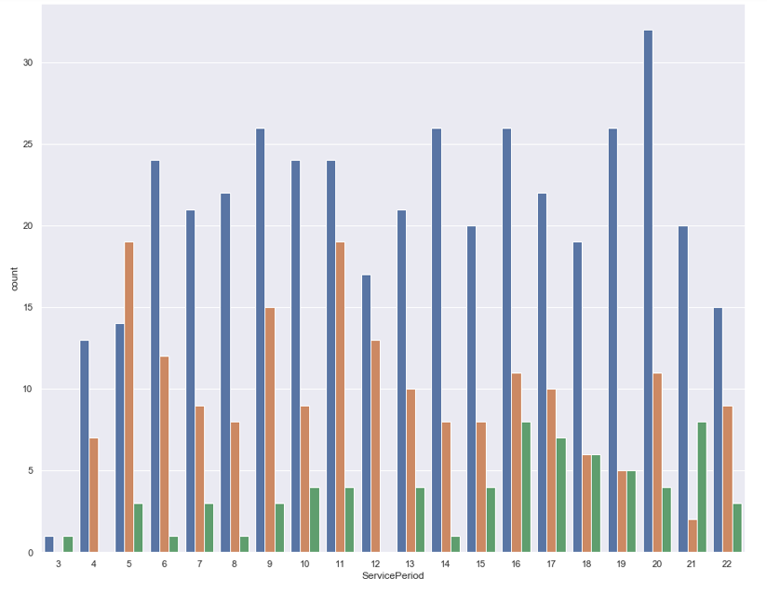


Slide 13
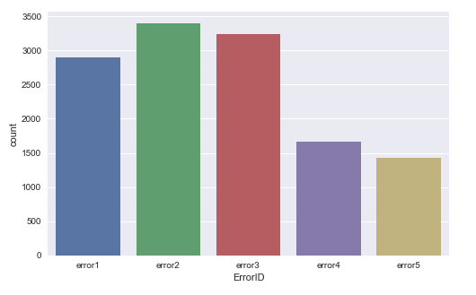
ComplaintsLog

Slide 14
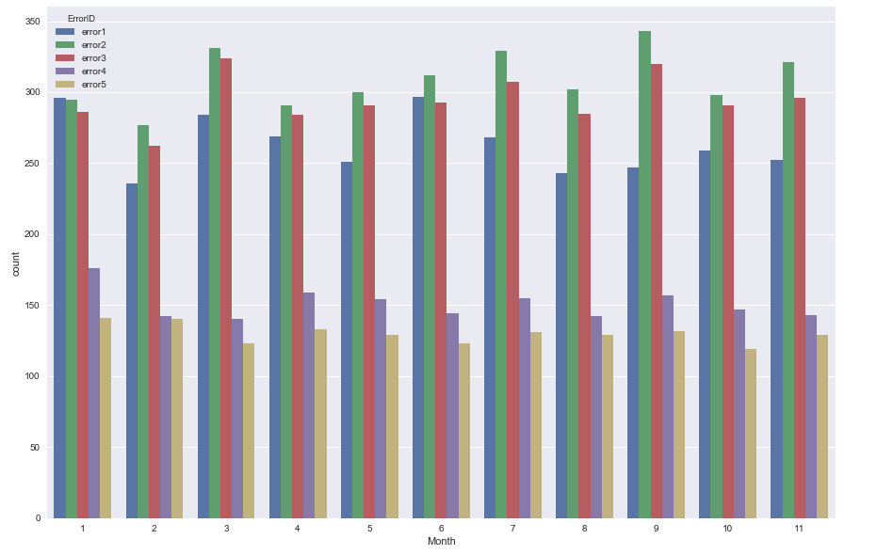

Slide 15
Data Insights & Feature engineering
Every time error1 happens, next day part is replaced
Every time error5 happens, next day part is replaced
Every time error 2 & error 3 happens at the same time the very next day part is replaced. Same is the not the case when the errors happen individually.
Feature Engineering: Error wise recency, Error wise frequency, Error wise average time gap, Average time gap between any two errors.

Slide 16
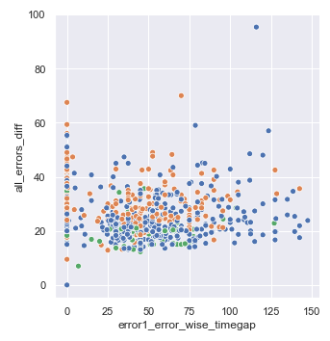
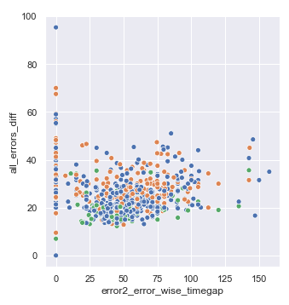
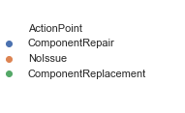

Slide 17
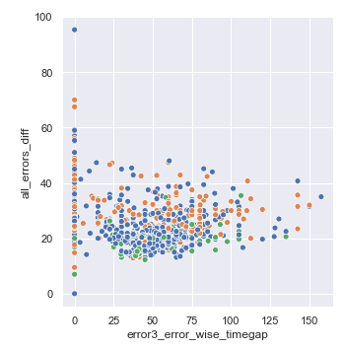
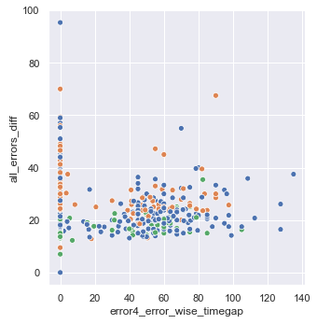

Slide 18
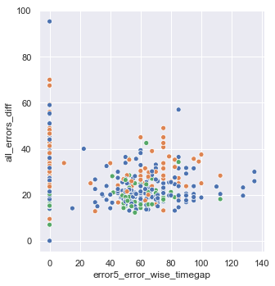

Slide 19
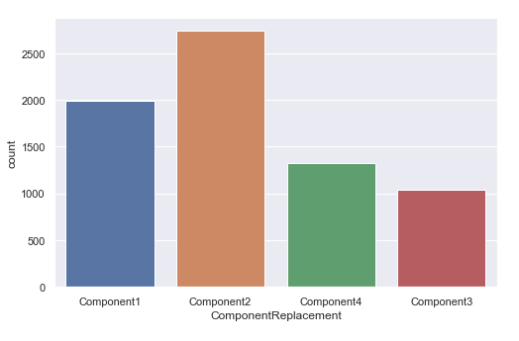
Component Replacement Log

Slide 20
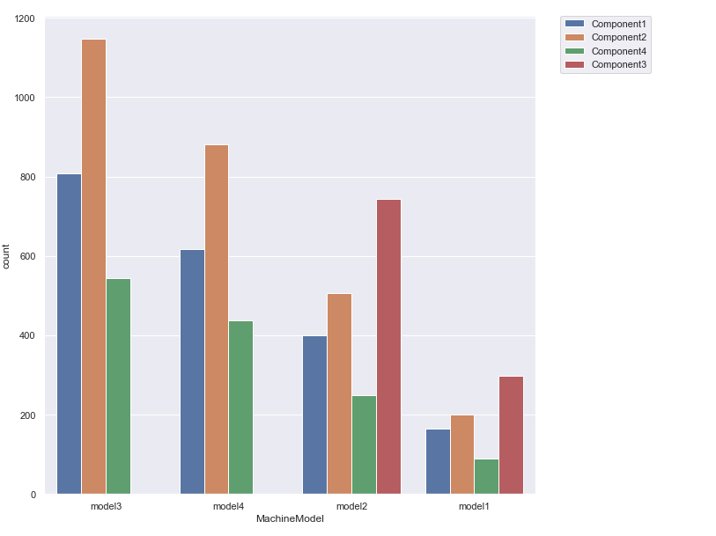

Slide 21
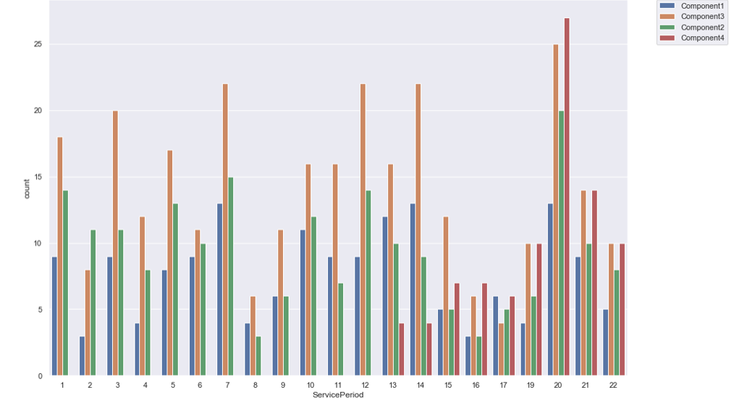
Model 1 Machine ID’s

Slide 22
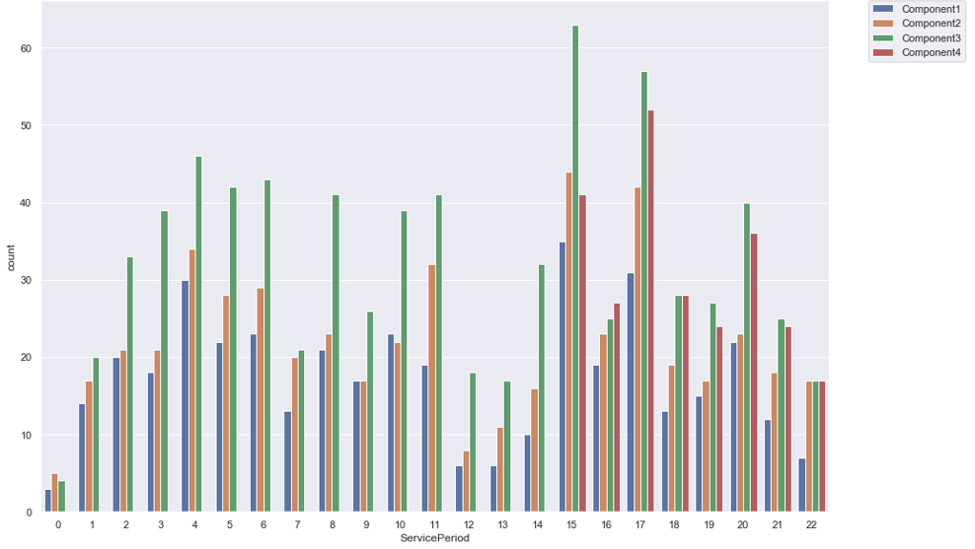
Model 2 Machine ID’s

Slide 23
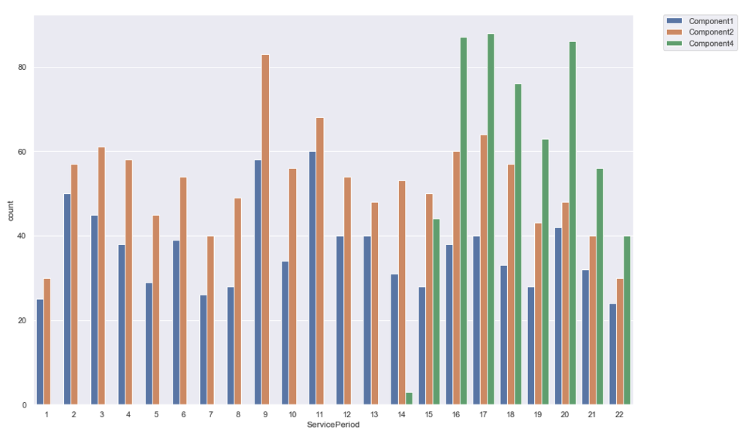
Model 3 Machine ID’s

Slide 24
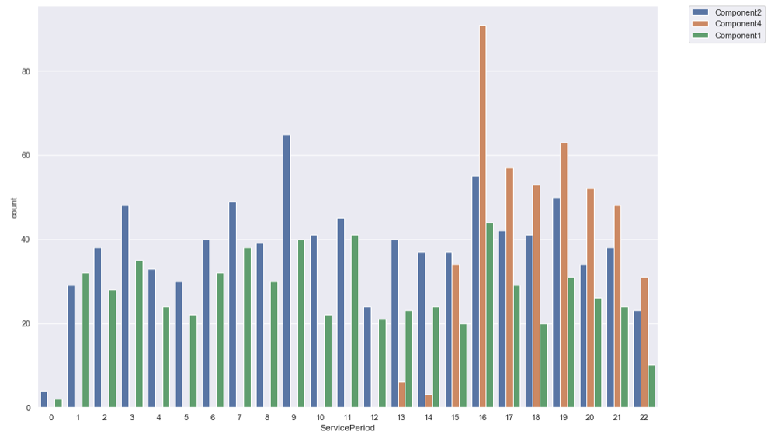
Model 4 Machine ID’s

Slide 25
Data Insights & Feature Engineering
Component 3 is never replaced for Model 3 and Model 4 which might indicate that it is not present in those models
If the service period is less than 13-14 , replacement of component 4 is a rarity for all the models
Feature Engineering: Component wise frequency of replacement, recency of replacement, average time gap between two consecutive replacements of same components and all the components.

Slide 26
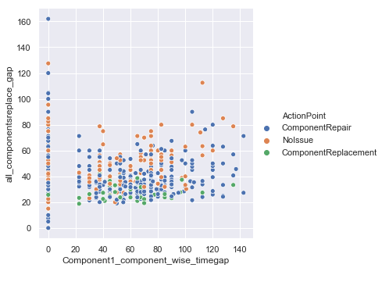
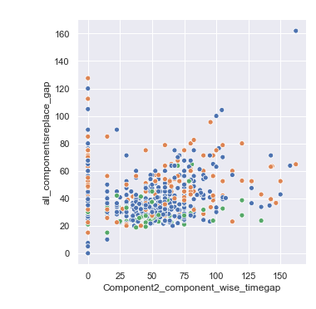

Slide 27
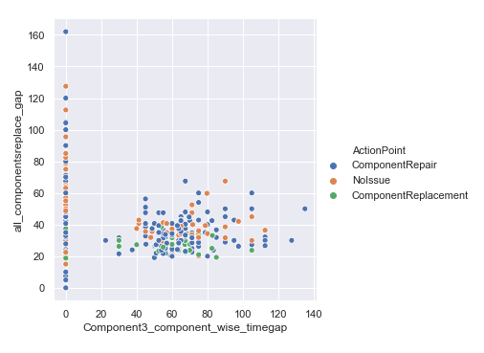
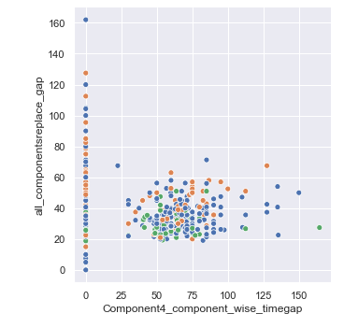

Slide 28
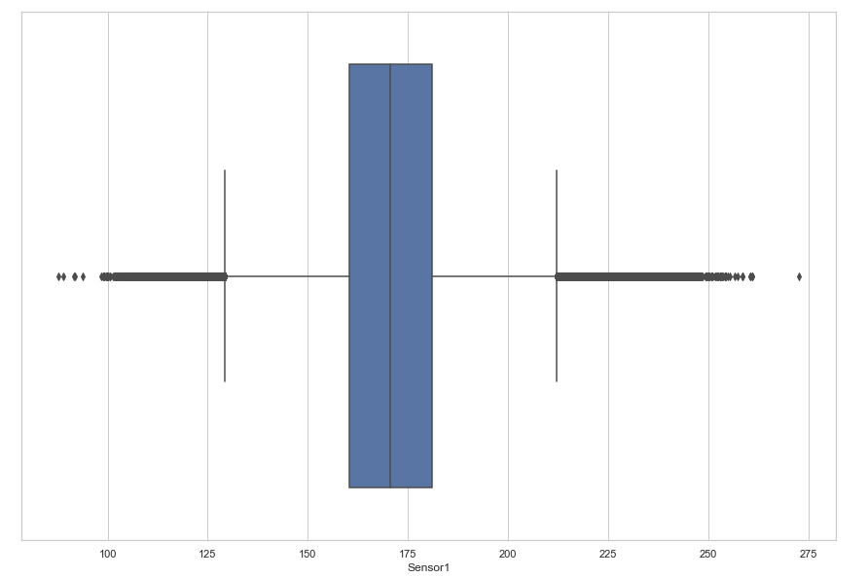
Sensors data

Slide 29
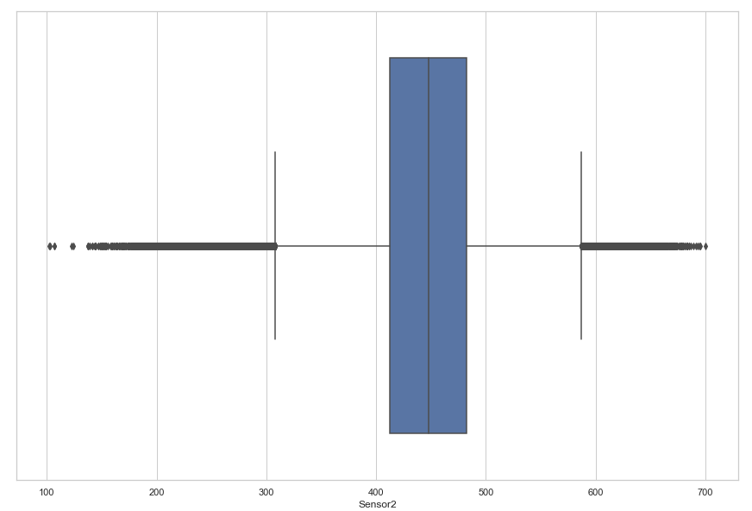

Slide 30
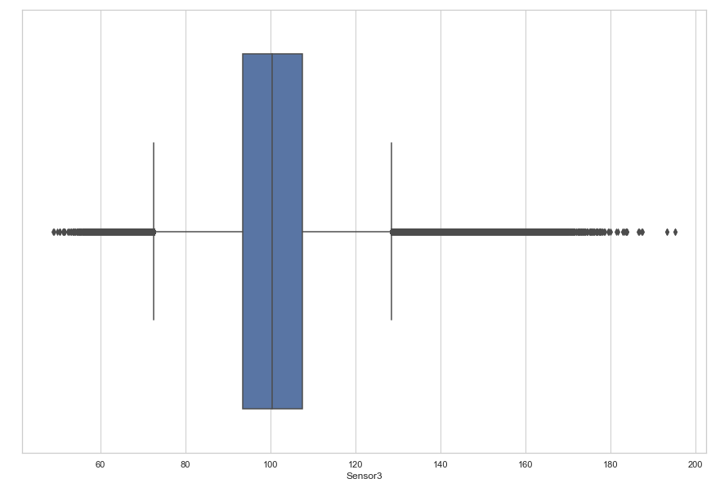

Slide 31
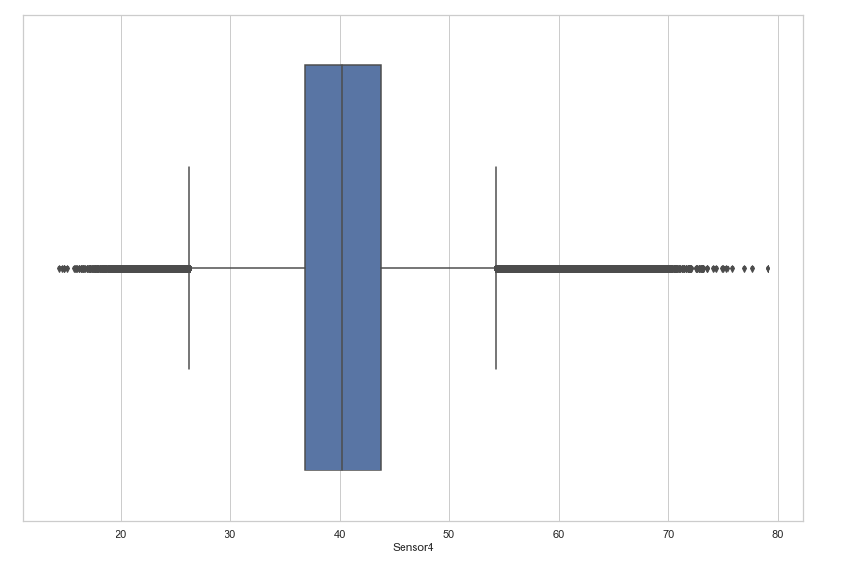

Slide 32
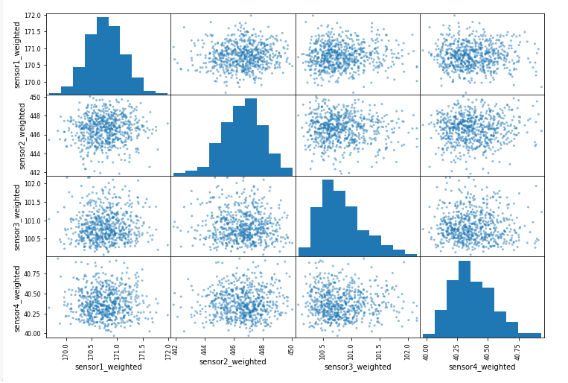

Slide 33
Data Insights & Feature Engineering.
Every time the reading of the sensor1, sensor 2, sensor 4 is below the lower whisker, component 1, component 2, component 4 is replaced with in a span of three –four days.
Sensor 1, Sensor 2, Sensor 3 & Sensor 4 looks like are tracking the components 1, 2,3, 4 respectively of Machine
This does not apply to Sensor 3, although the reading falls below the lower whisker.
Feature Engineering: Weighted average of components sensor reading with highest weightage to the recent rating.
Minimum sensor reading in the last week of the given data along with the recency.

Slide 34
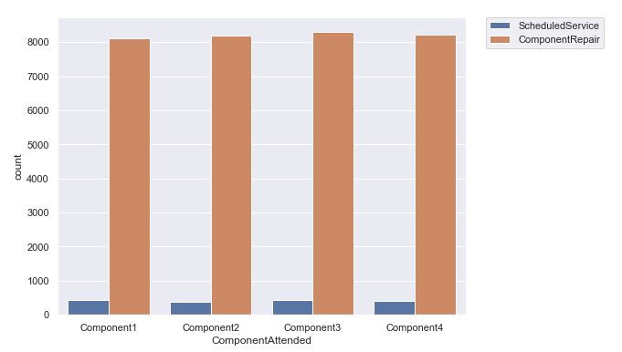
Services Data

Slide 35
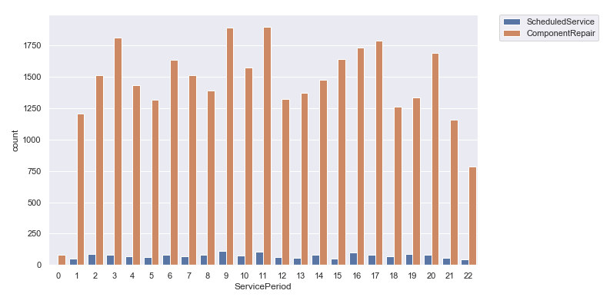

Slide 36
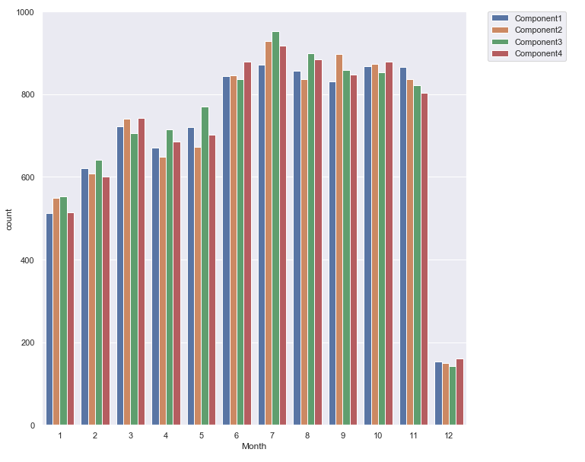

Slide 37
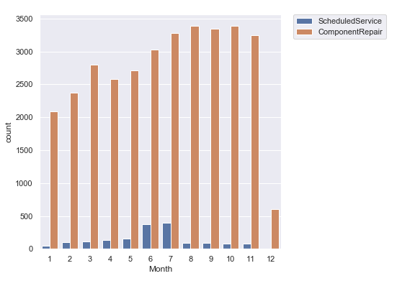

Slide 38
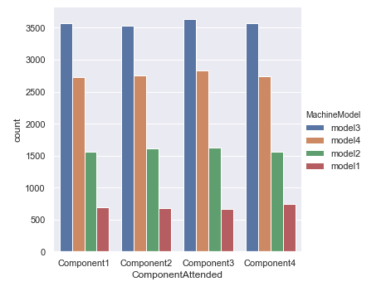

Slide 39
Data Insights & Feature Engineering.
Unscheduled servicing is the major way of maintenance for the manufacturing unit.
In months 6 and 7, many machines have the scheduled service due date.
Feature Engineering: Component wise receny of service, frequency, time gap between two consecutive component services and two consecutive services of same component,
Service type wise recency of service, frequency, time gap between two consecutive services of same type.

Slide 40
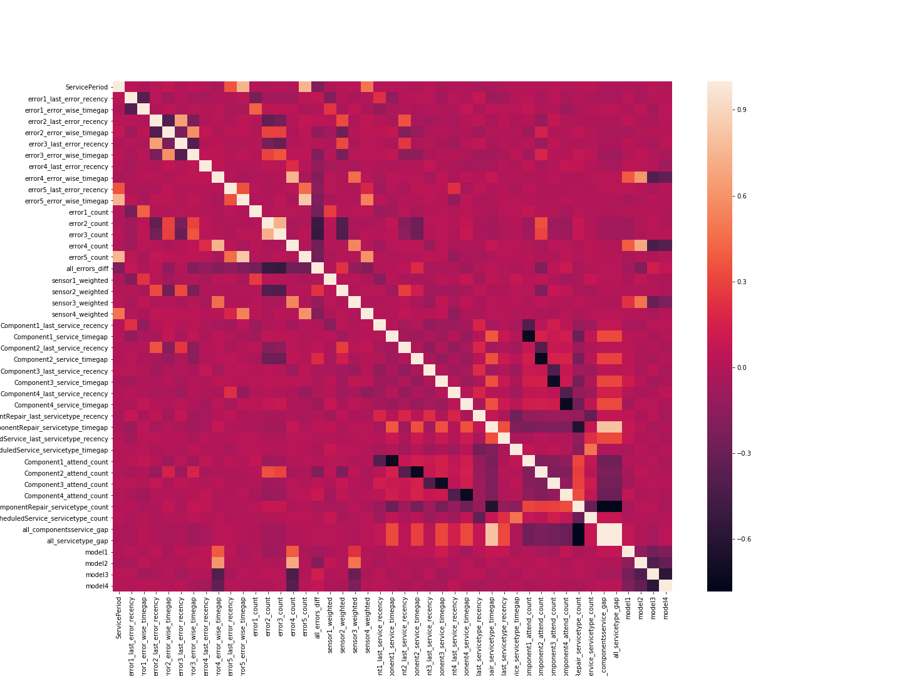
Correlation Plot between the features created

Slide 41
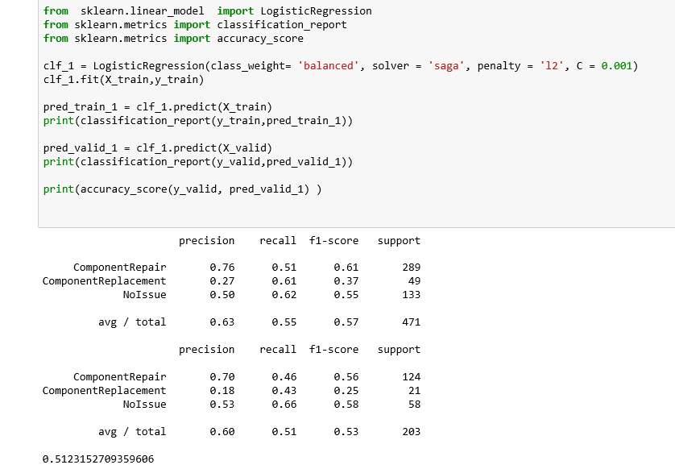
Logistic Regression

Slide 42
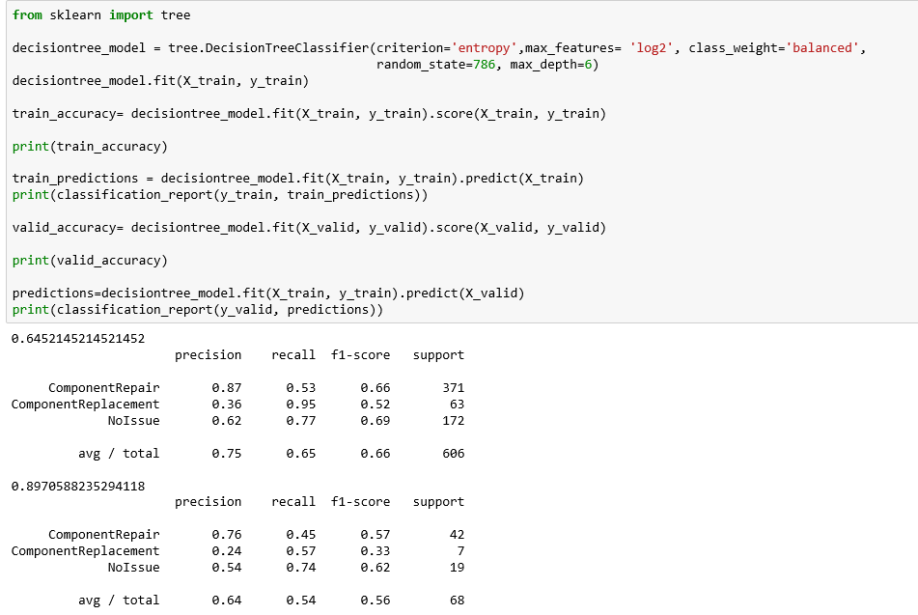
Decision Tree

Slide 43
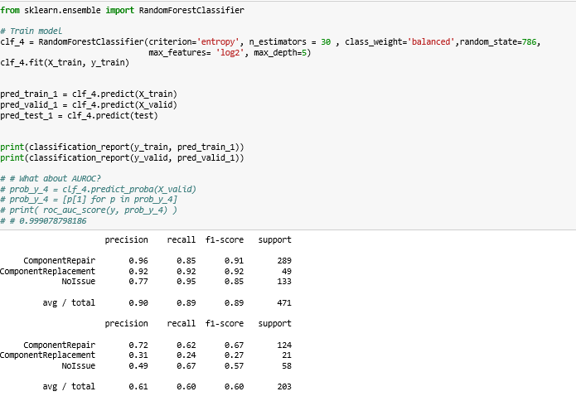
Random Forest

Slide 44
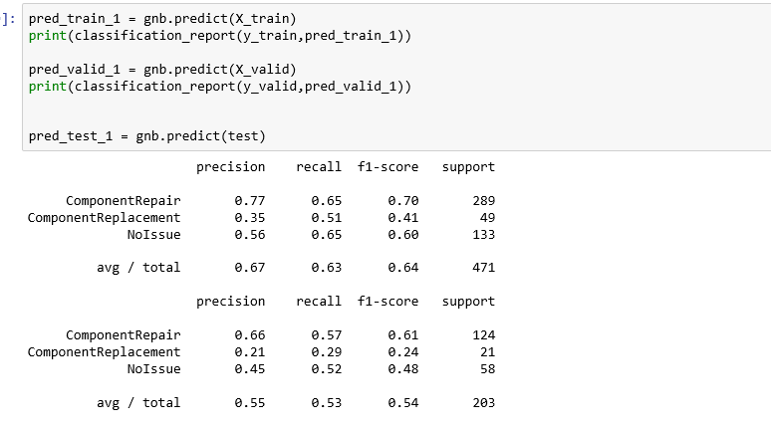
Naive Bayes

Slide 45
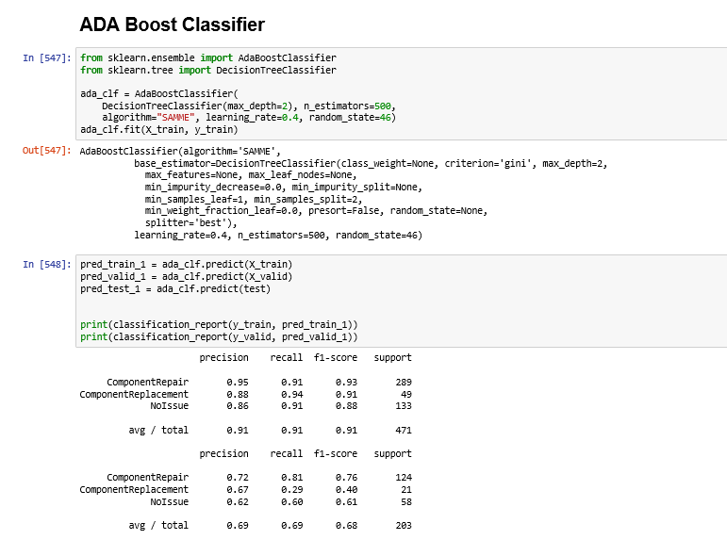

Slide 46
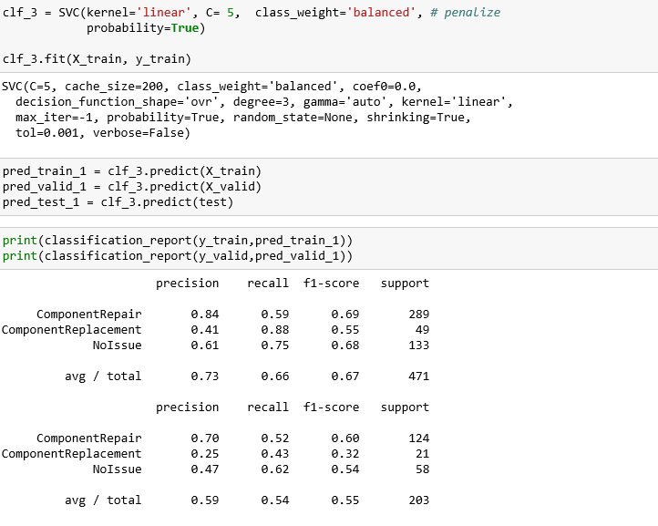
Support Vector Classifier

Slide 47
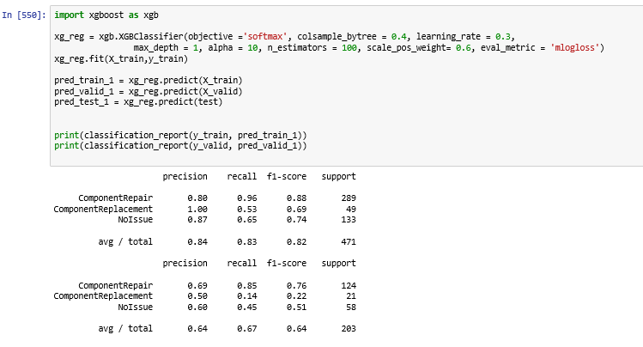
XG Boost

Slide 48
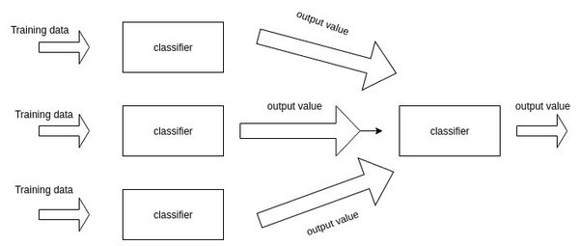
Stacking
Stacking is a way of combining multiple models.
Stacking Model is created by combining the outputs of ADA Boost, Naive Bayes, Logistic Regression, Random forest, Support Vector Classifier, XG Boost as input features to Decision Tree.

Slide 49
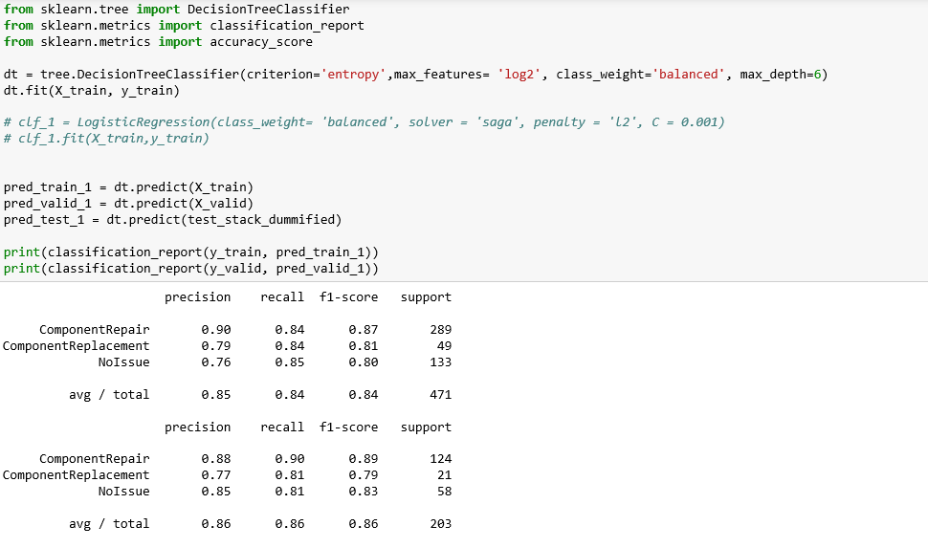
Stacking

Slide 50
Summary of Results
Algorithm | Train | Validation | Grader
Logistic | 37 | 25
Decision Tree | 52 | 33 | 17
Random Forest | 92 | 27 | 22
Naive Bayes | 41 | 24 | 27
SVC | 55 | 32 | 38*
Ada Boost | 91 | 40 | 30
Gradient Boost | 100 | 0
XG Boost | 69 | 22
Stacking | 74 | 70 | 30

